Slide 1
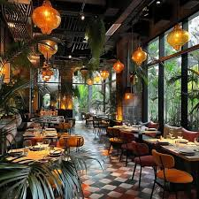
Restaurant Order Analysis

Slide 2

Overview
This is the project of Analyzing the Restaurant orders. Here we have two tables “Order Details” and “Menu items”, which include order ID, menu item ID, cuisine category, order date, order time, item name, and price.
We will analyze the item purchase trends, customer behavior, top purchased items, and the number of items under each cuisine.

Slide 3
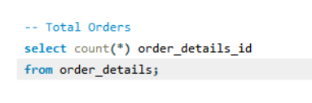
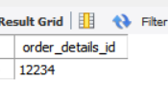
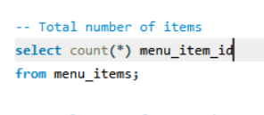

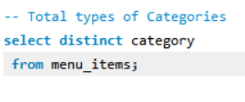
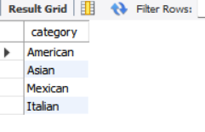
KEY POINTS
Total Orders:
Total Menu items:
Types of categories:

Slide 4

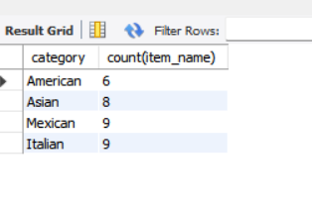

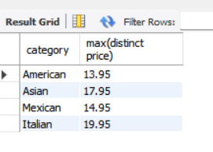
How many dishes are in each category?
Analyzing the Menu Items
Max-priced item from each category

Slide 5
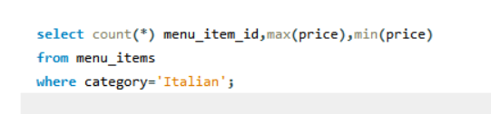
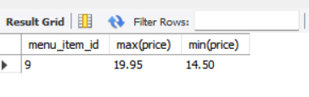
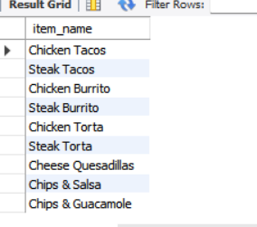
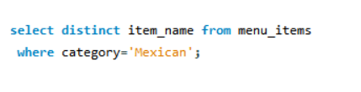
How many Italian dishes are on the menu? What are the least and most expensive Italian dishes on the menu?
Give the menu items list from the Mexican category

Slide 6

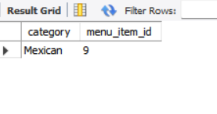
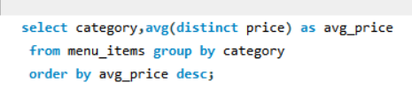
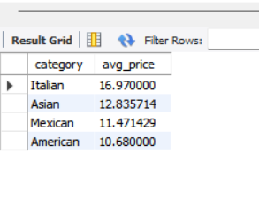
Give the count of menu items from the Mexican category
What is the average dish price within each category?

Slide 7
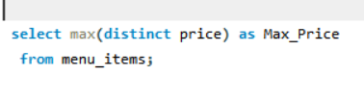
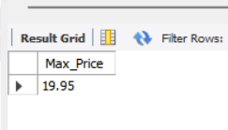

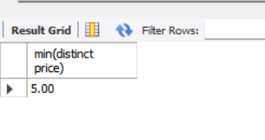
Gives Max priced items from all items
Gives Min priced items from all items

Slide 8
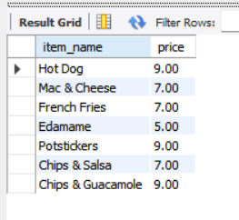
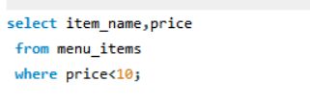
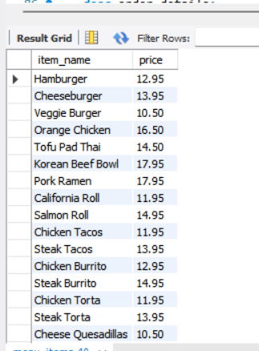
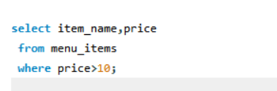
Gives the list of items below $10
Gives the list of items above $10

Slide 9

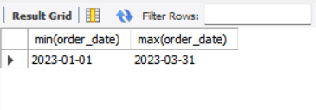
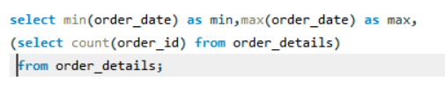
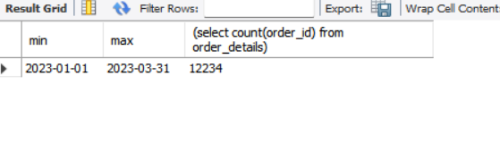
Analyzing the Orders and the details
What is the date range of the table?
How many orders were made within this date range?

Slide 10
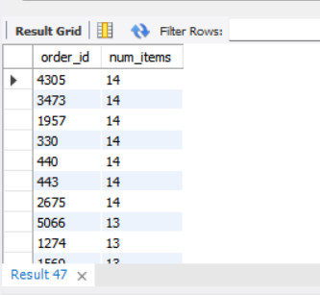
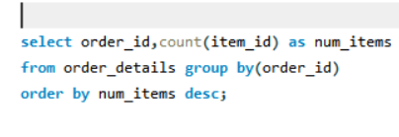
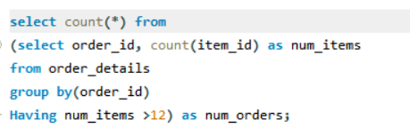
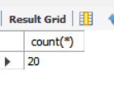
which orders had the most no. of items?
How many orders had more than 12 items?

Slide 11
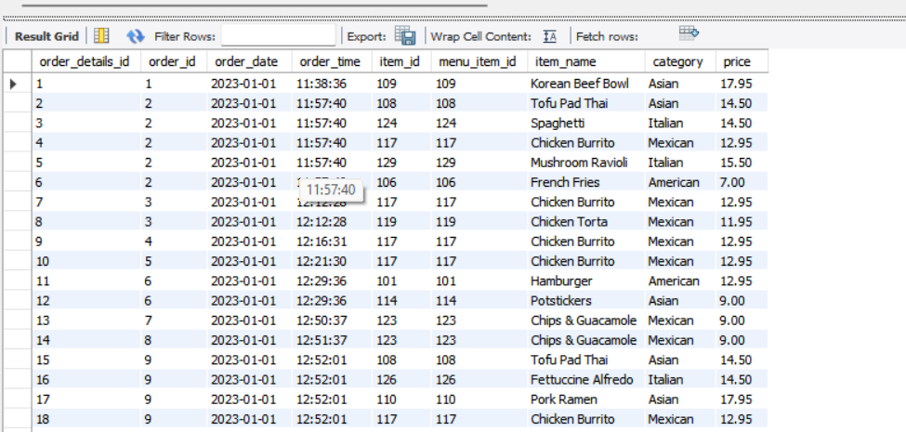
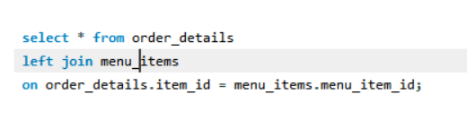
Analysing Customer Behaviour
Combine the menu_items and order_details tables into a single table

Slide 12
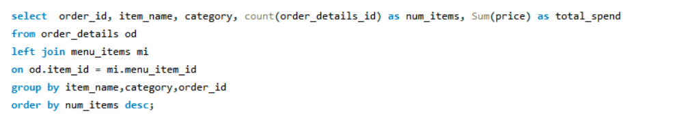
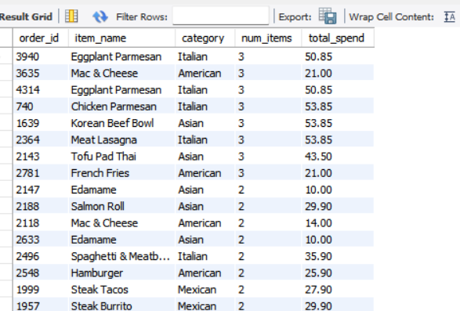
What were the least and most ordered items? What categories were they in?

Slide 13
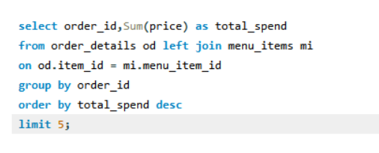
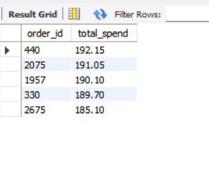
What were the top 5 orders that spent the most money?

Slide 14
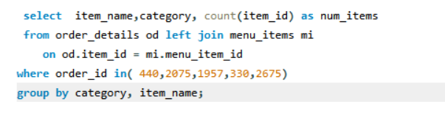
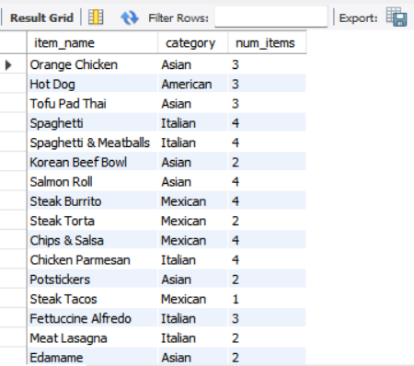
View the details of the highest spend order. Which specific items were purchased?

Slide 15
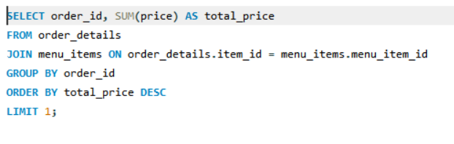
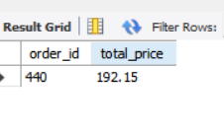
How much was the most expensive order in the dataset?

Slide 16
Take Aways:
Total menu items: 32
Total categories: 4
Total Orders: 12,234
Max priced items: Shrimp Scampi, Italian, $19.95
Min priced Item: Edamame, Asian, $5.00
Most purchased Items: Eggplant Parmesan, Italian, 3 times
Most expensive orders:
order ID: 440,
Total spend:$192.15

Slide 17
Thank you

